Slide 1
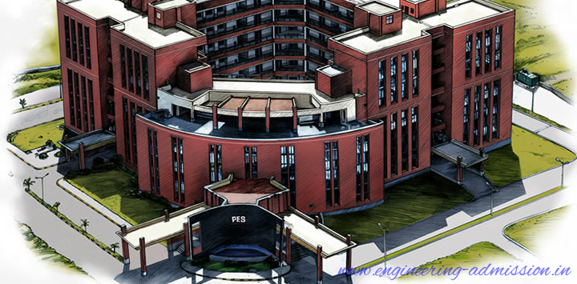

(Electronic city campus)
Department Of Mechanical Engineering
MECHANICAL ENGINEERING SCIENCE (MES)
(UE18ME101)
Prof. Sateesh Mudalagi

Slide 2
Unit – 2
Thermal energy system

Slide 3
Introduction
All energy cannot be used as work
Convertibility of energy in to work depends on its availability
Thermodynamics
Thermo – Heat Dynamics – Power or Motion
Interaction of energy in the form of Heat and Work
Two forms
Classical Thermodynamics: Macrostructure of matter
(Large aggregation of Molecules)
Statistical Thermodynamics: Microstructure of matter
( Individual Molecules)

Slide 4
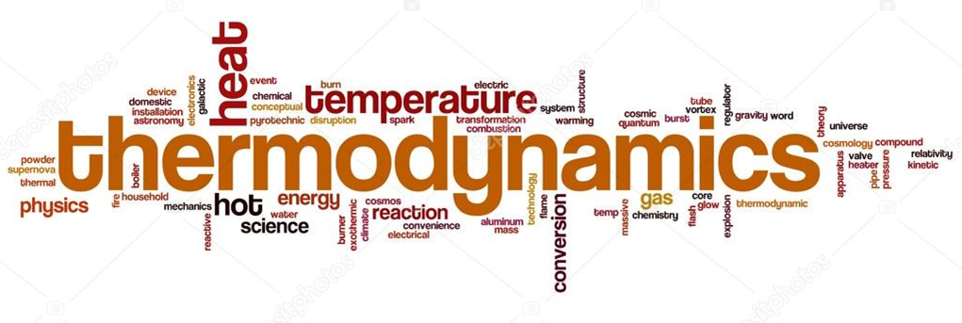
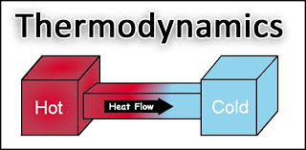
Terminologies used in Thermodynamics
It is the field of thermal engineering that studies the properties of system that have a temperature and involve the laws that govern the conversion of energy from one form to another, the direction in which heat will flow, and the availability of energy to do work.

Slide 5
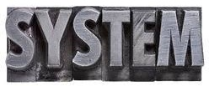
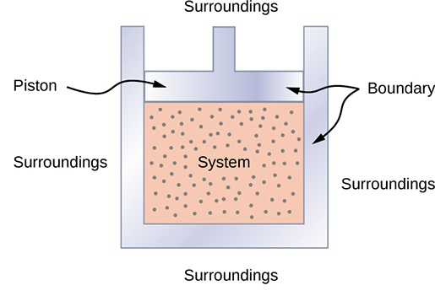
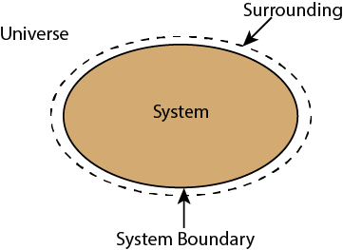
Terminologies used in Thermodynamics
It is the fixed quantity of matter and/or the region that can be separated from every thing else by a well defined boundary/surface.

Slide 6
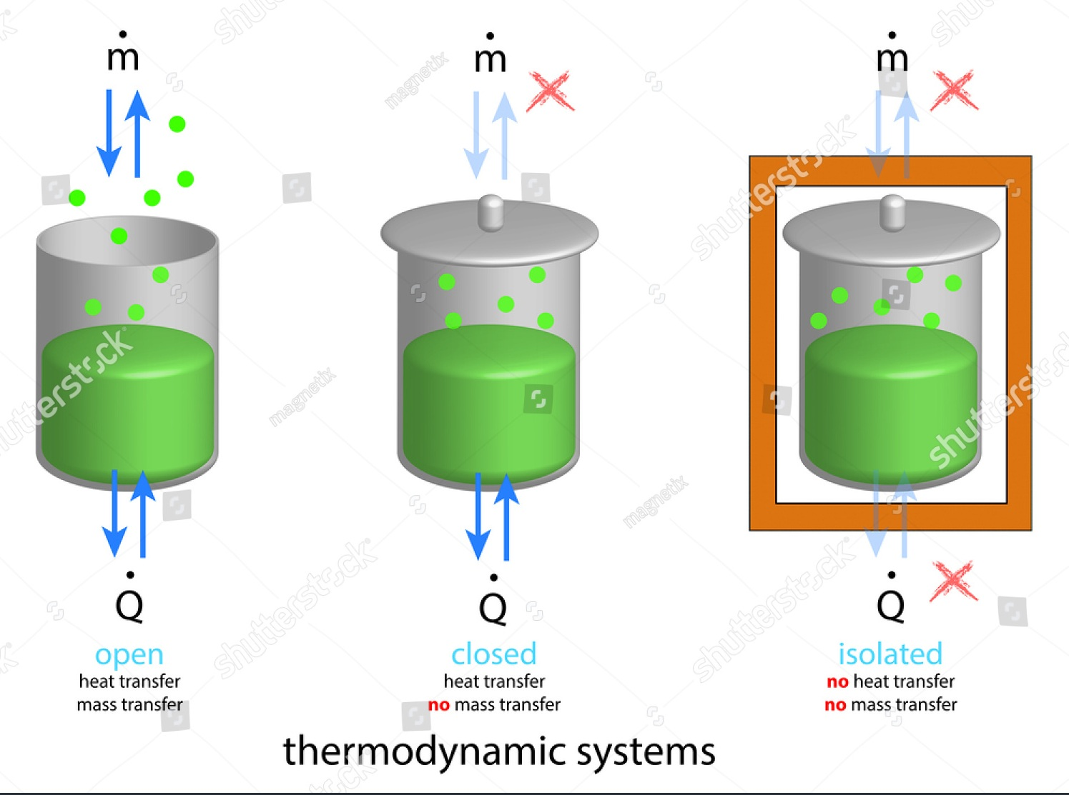

Slide 7
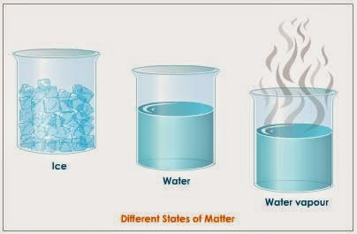
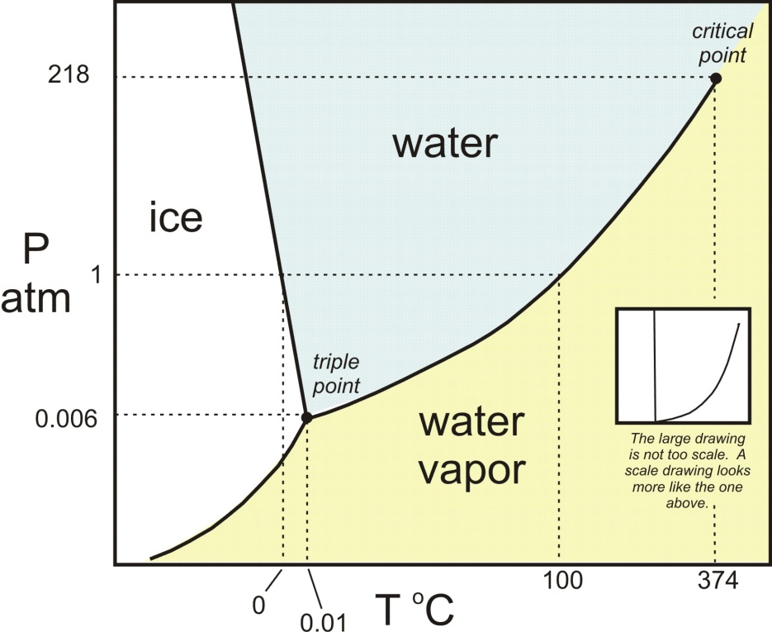
Terminologies used in Thermodynamics
STATE
At any instant of time, the condition of system
Property is in any quantity whose numerical values depends on state but on the history of the process

Slide 8
Intensive Properties
Independent on size or extent of the system
(Pressure, Temperature…etc)
Extensive Properties
Depends on size or extent of the system
(Mass, Volume, Entropy..etc)

Slide 9
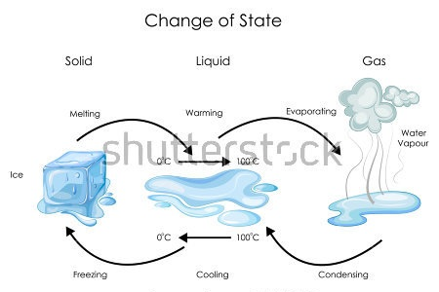
Terminologies used in Thermodynamics
Change of STATE
Changes due to flow of mass and energy

Slide 10
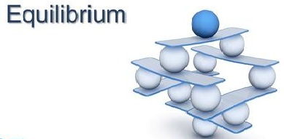
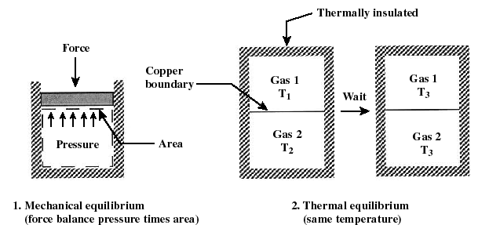
Terminologies used in Thermodynamics
Includes balancing of forces, Thermal, pressure, chemical and Phase equilibrium

Slide 11
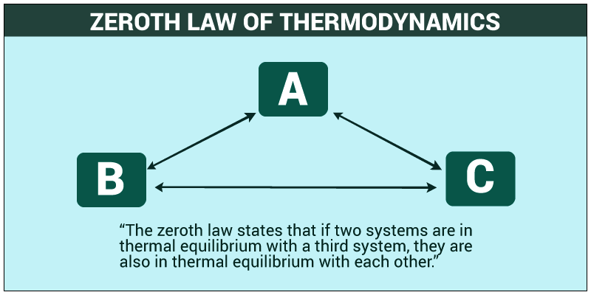
Terminologies used in Thermodynamics

Slide 12

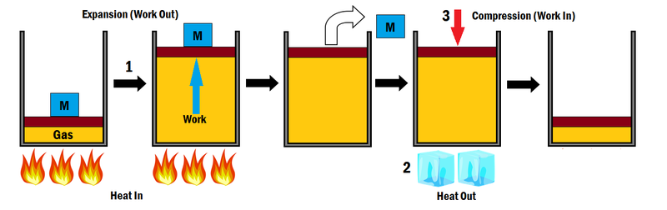
Terminologies used in Thermodynamics
Any quantity of energy that flows across the boundary between the system and surrounding which can be used to change the height of mass in the surrounding

Slide 13

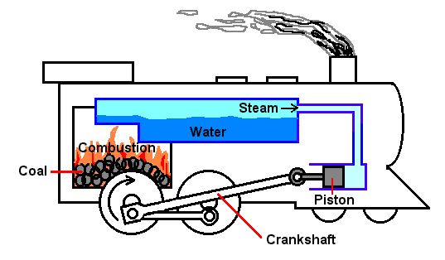
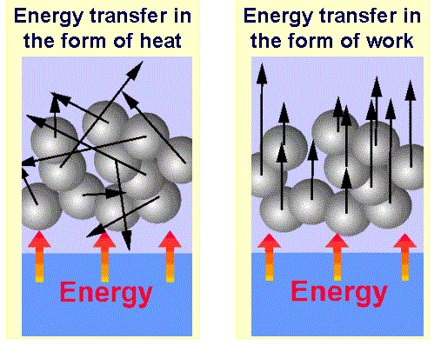
Terminologies used in Thermodynamics
Any quantity of energy that flows across the boundary between the system and surrounding because of temperature difference between system and surrounding

Slide 14
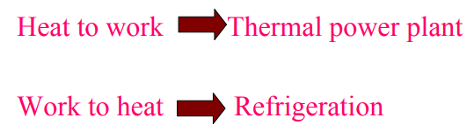
Heat and Work
Work (W) in mechanics is displacement (d) against a resisting force (F). W = F × d
Work has units of energy (Joule, J).
Work can be expansion work (PΔV), electrical work, magnetic work etc.
Heat as used in TD is a tricky term
➢ The transfer of energy as a result of a temperature difference is called heat. ➢ “In TD heat is NOT an entity or even a form of energy; heat is a mode of transfer of energy” . ➢ “Heat is the transfer of energy by virtue of a temperature difference”. ➢ “Heat is the name of a process, not the name of an entity”. ➢ “Bodies contain internal energy (U) and not heat”.
Work is coordinated flow of matter. ➢ Lowering of a weight can do work ➢ Motion of piston can do work ➢ Flow of electrons in conductor can do work.
Heat involves random motion of matter. ➢ Like gas molecules in a gas cylinder ➢ Water molecules in a cup of water ➢ Atoms vibrating in a block of Cu.

Slide 15
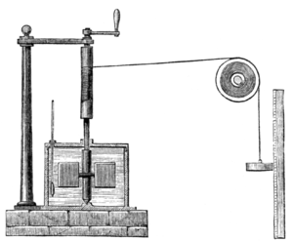
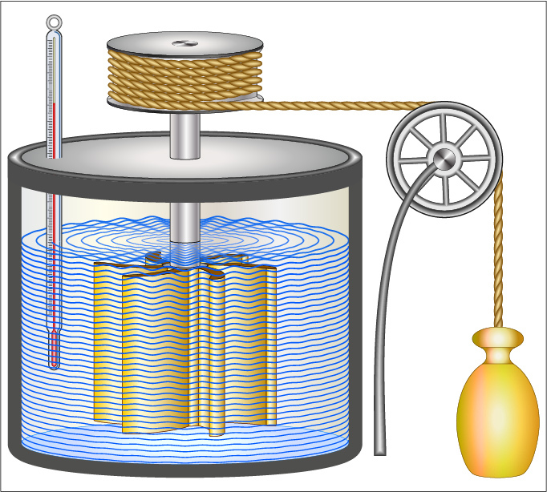
First Law of Thermodynamics
It is equivalent to law of conservation of energy
It deals with the transfer of heat energy in to work and vice versa
For closed system, energy can be transferred by heat and work transfer.
In thermodynamics the term work denotes a means for transferring energy
Fig. Mechanical Equivalent of Heat

Slide 16
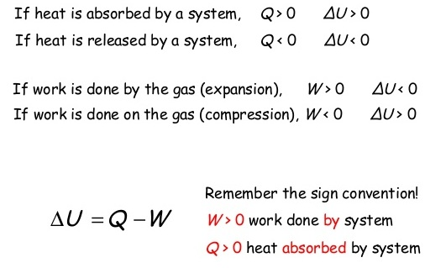
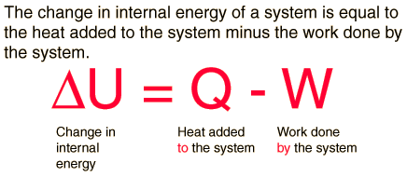

Slide 17
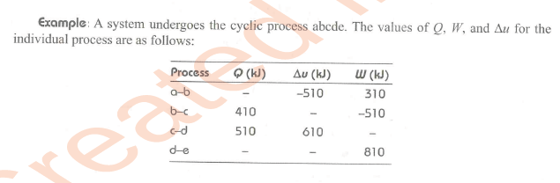

Slide 18
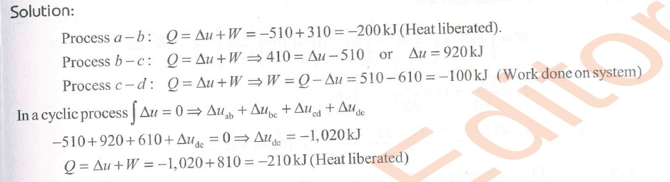

Slide 19
Limitations of 1st Law of Thermodynamics
It does not indicate the direction of heat transfer
It does not tell anything about the condition, under which heat can be transformed in to work
It does not indicate as to why the whole of the heat energy can not be converted in to mechanical work

Slide 20
Second Law of Thermodynamics
Definitions
Kelvin – Plank Statement
No process is possible whose sole result is the absorption of heat from a reservoir and the complete conversion of the heat in to work
i.e Heat can not be converted 100% into work in a cyclic process
Eg: Heat Engine
Clausius Statement
No process is possible whose sole result is the transfer of heat from colder object to hotter object
i.e Heat does not spontaneously flow from cold to hot object.
Eg: Heat Pump, Refrigerator

Slide 21
Heat Engine
Heat Pump
Refrigerator

Slide 22
Introduction to IC Engine
=
Heat engine
It can be defined as any engine that converts thermal energy to mechanical work output. Examples of heat engines include: steam engine, diesel engine, and gasoline (petrol) engine.
On the basis of how thermal energy is being delivered to working fluid of the heat engine, heat engine can be classified as an internal combustion engine and external combustion engine.
In an Internal combustion engine, combustion takes place within working fluid of the engine, thus fluid gets contaminated with combustion products.
Petrol engine is an example of internal combustion engine, where the working fluid is a mixture of air and fuel .
In an External combustion engine, working fluid gets energy using boilers by burning fossil fuels or any other fuel, thus the working fluid does not come in contact with combustion products.
Steam engine is an example of external combustion engine, where the working fluid is steam.

Slide 23
Classification of IC Engines
(a) Based on number of strokes :
(i) Two stroke engines
(ii) Four stroke engines
(b) Based on thermodynamic cycle :
(i) Engines based on Otto cycle (‘Spark-Ignition engine’)
(ii) Engines based on Diesel (‘Compression-Ignition engine’)
(c) Based on mechanism of ignition:
(i) Spark ignition engines
(ii) Compression ignition engines.

Slide 24
Classification of IC Engines Contd….
(d) Based on type of fuel used:
(i) Petrol engines (petrol being used as fuel)
(ii) Gas engines (gaseous fuel being used)
(iii) Diesel engines (diesel being used as fuel)
(iv) Multi-fuel engines (more than one fuel being used)
(e) Based on fuel admission:
(i) Carburetor type engines (use carburetor fuel metering)
(ii) Injection type engines (use fuel injector & injection system)
(f) Based on type of cooling:
(i) Air cooled engines (Small sized engines)
(ii) Water cooled engines (Large sized engines)

Slide 25
Classification of IC Engines Contd….
(g) Based on type of motion
(i) Reciprocating engines
(ii) Rotary engines
(h) Based on cylinder arrangements
(i) Opposed cylinder engines
(ii) Inclined cylinder engines
(iii) V-shaped cylinder arrangement

Slide 26
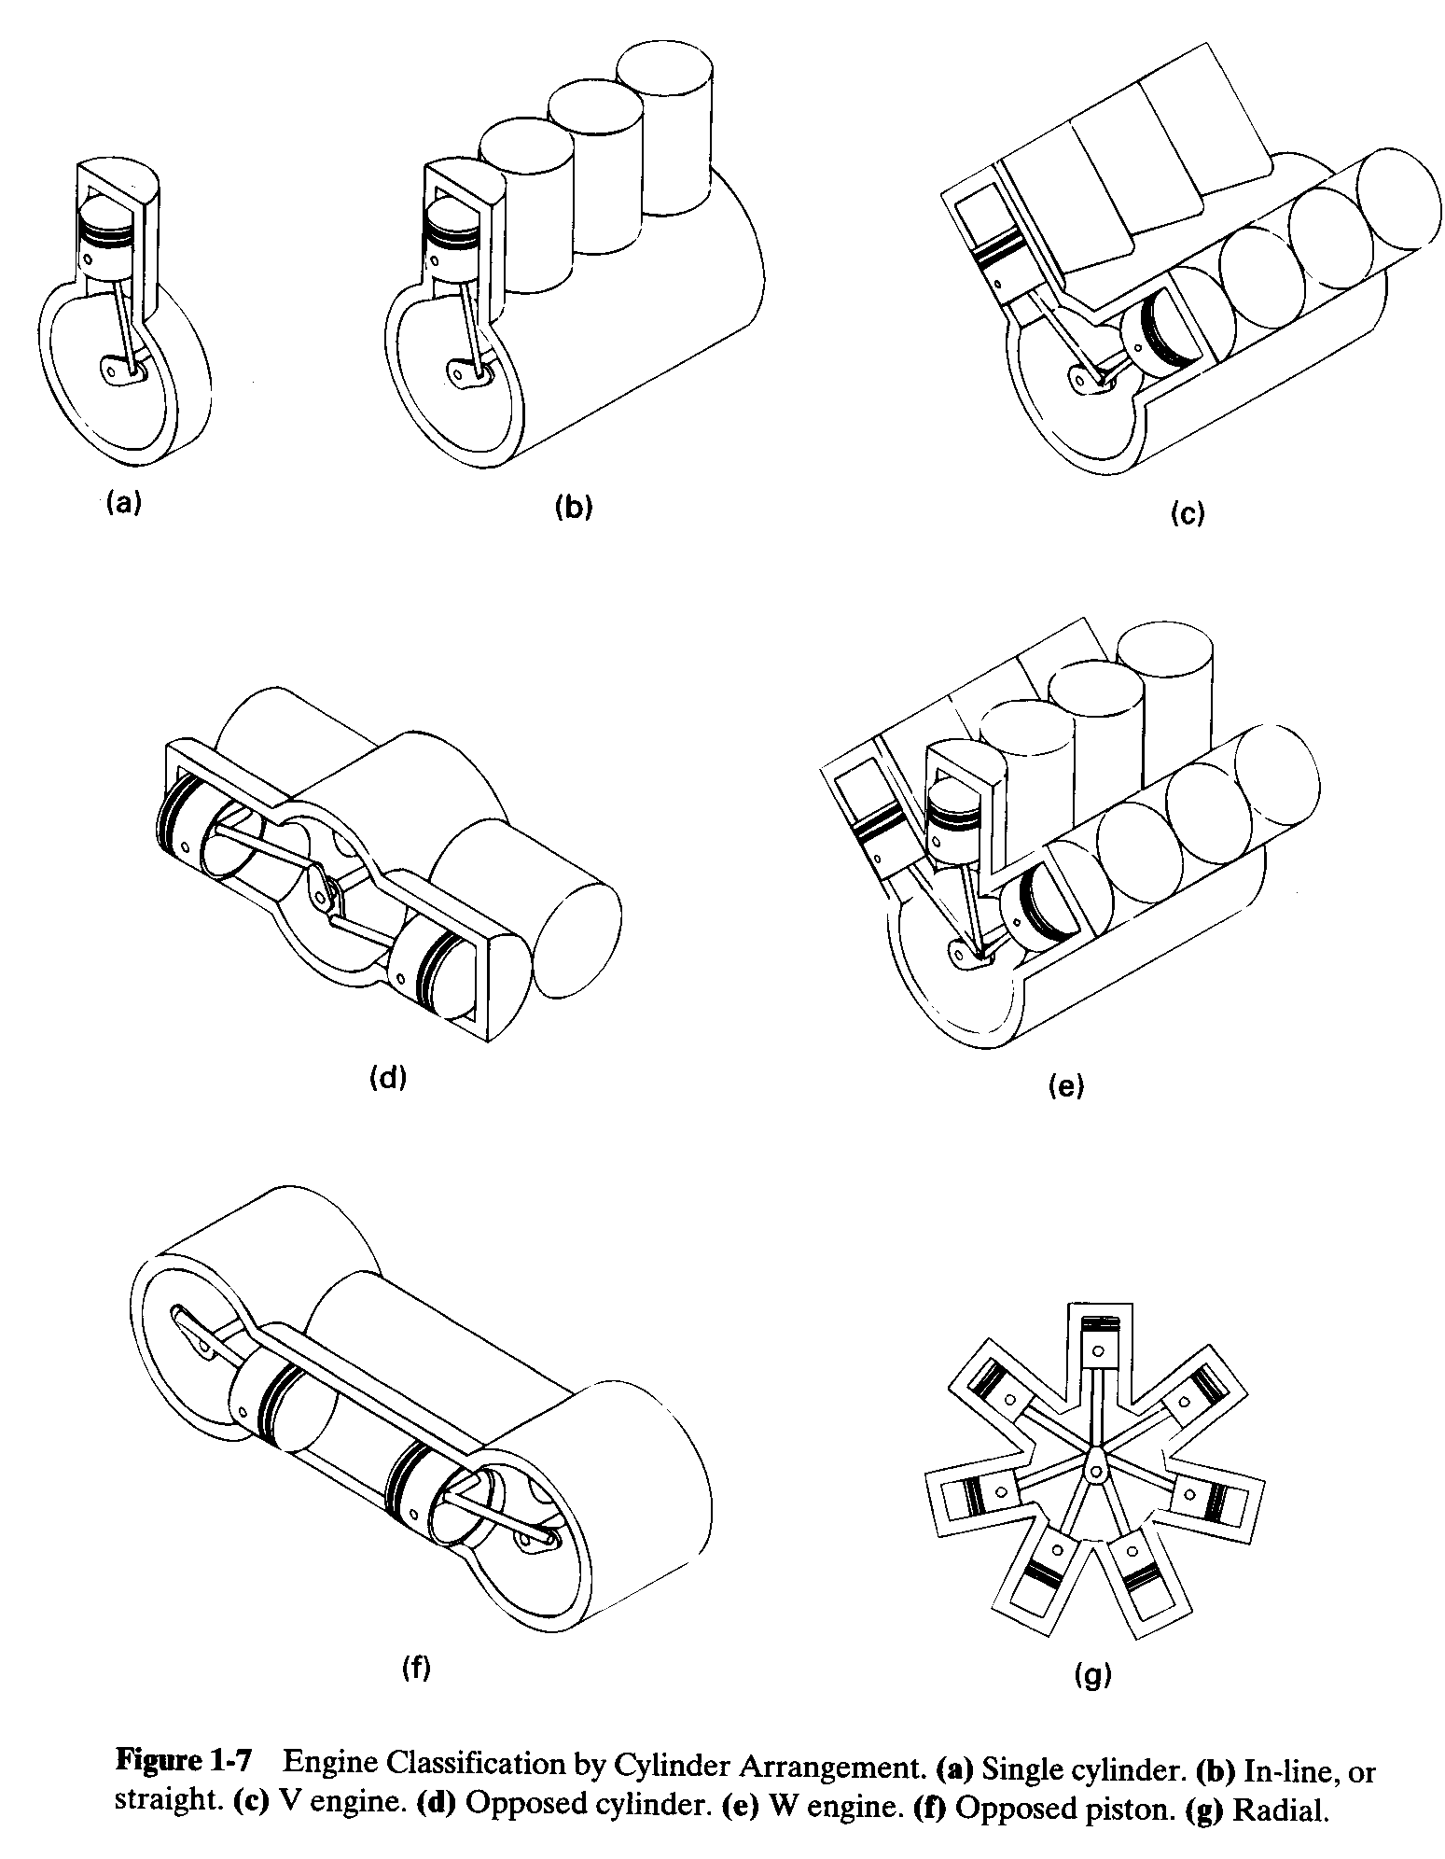
Single Cylinder Engine
Inline Engine
V - Engine

Slide 27
Opposed Cylinder Engine
W - Engine

Slide 28
Opposed Piston Engine
Radial Engine

Slide 29
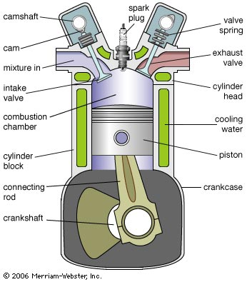
Basic Construction of IC Engine

Slide 30
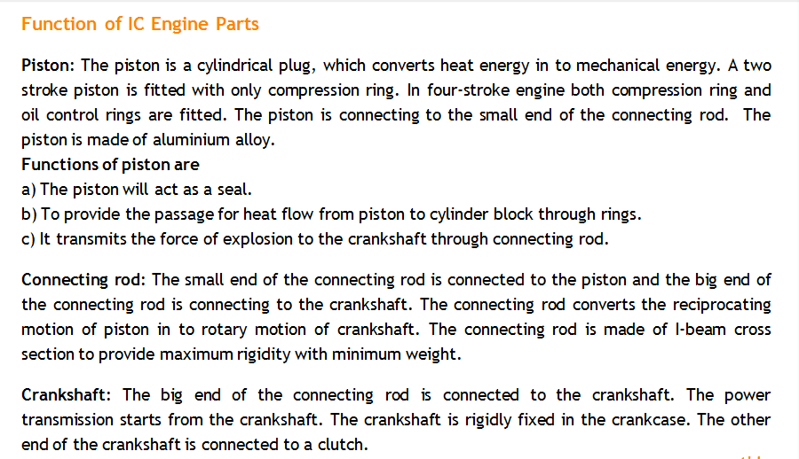

Slide 31
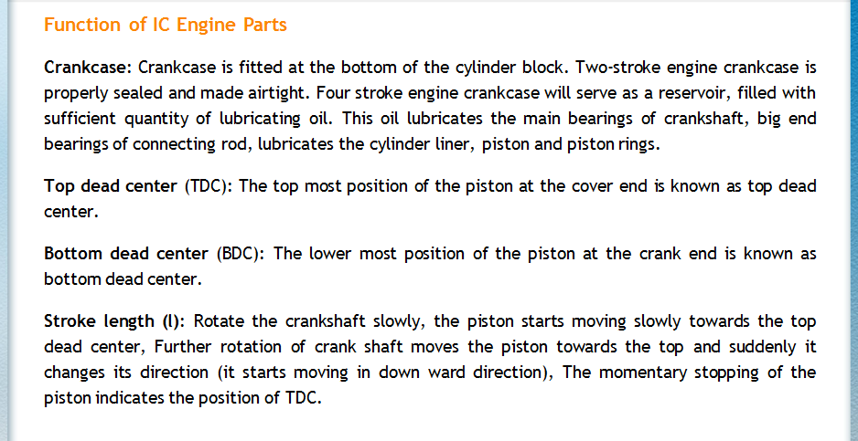

Slide 32
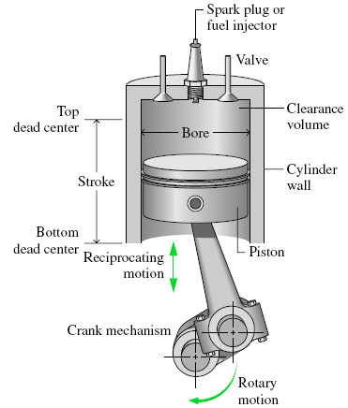
ENGINE NOMENCLATURE

Slide 33
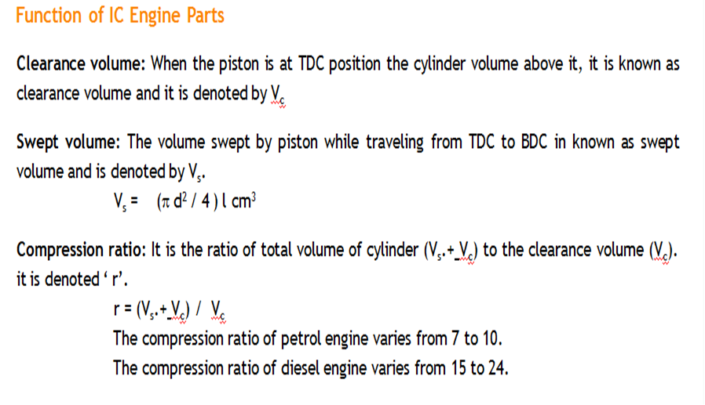

Slide 34
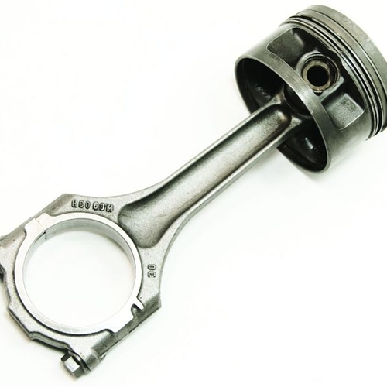
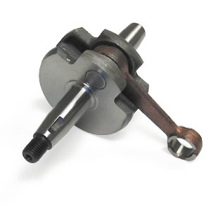
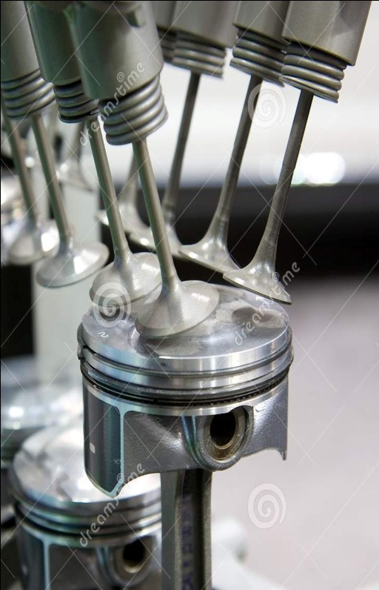
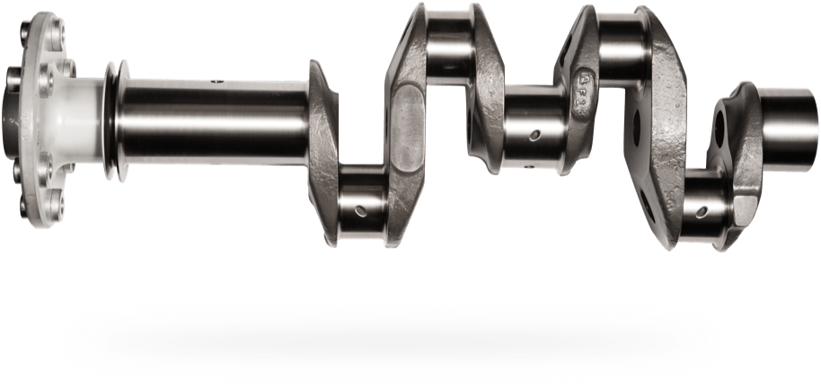
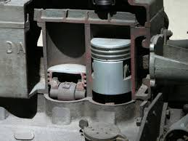
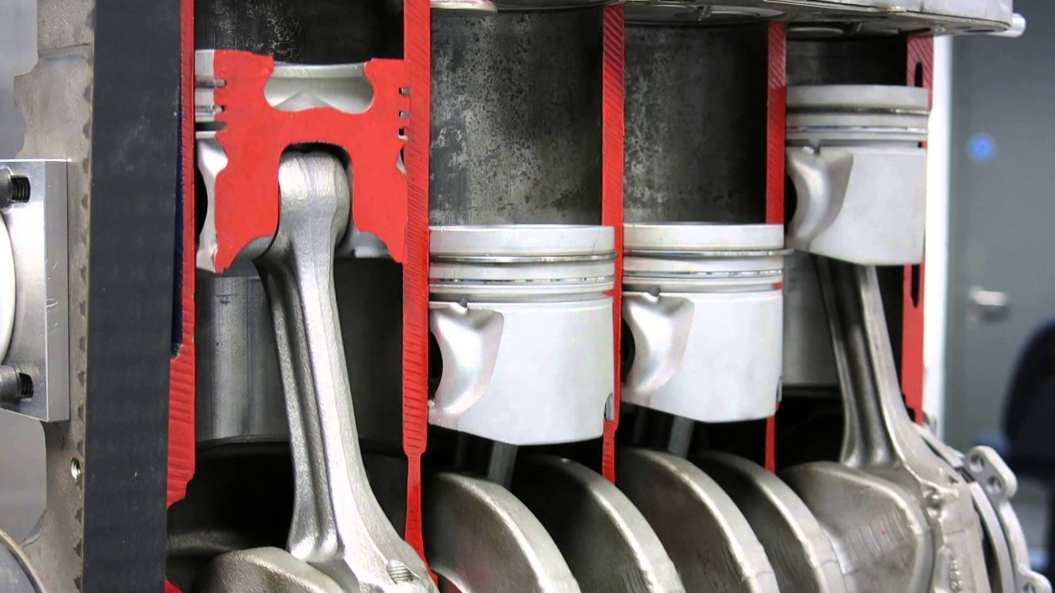

Slide 35
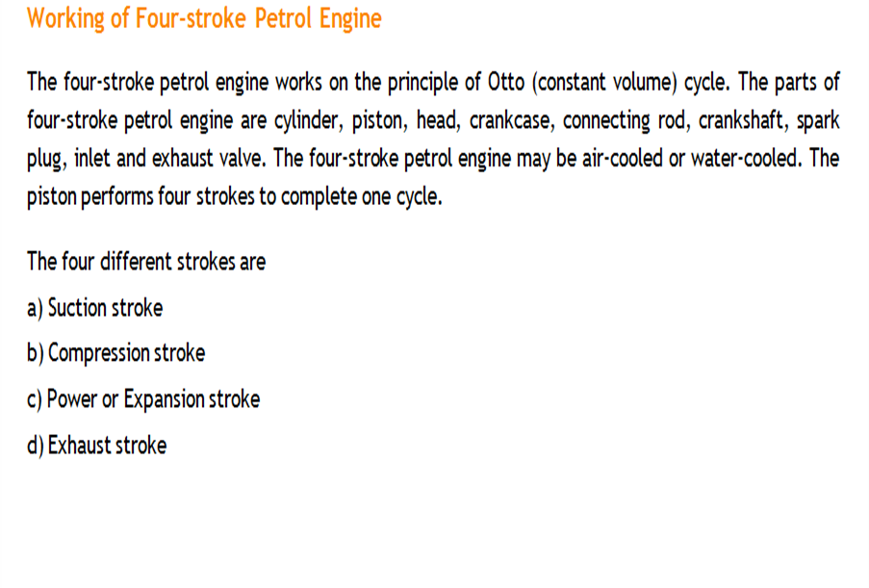
4 Stroke Petrol Engine

Slide 36
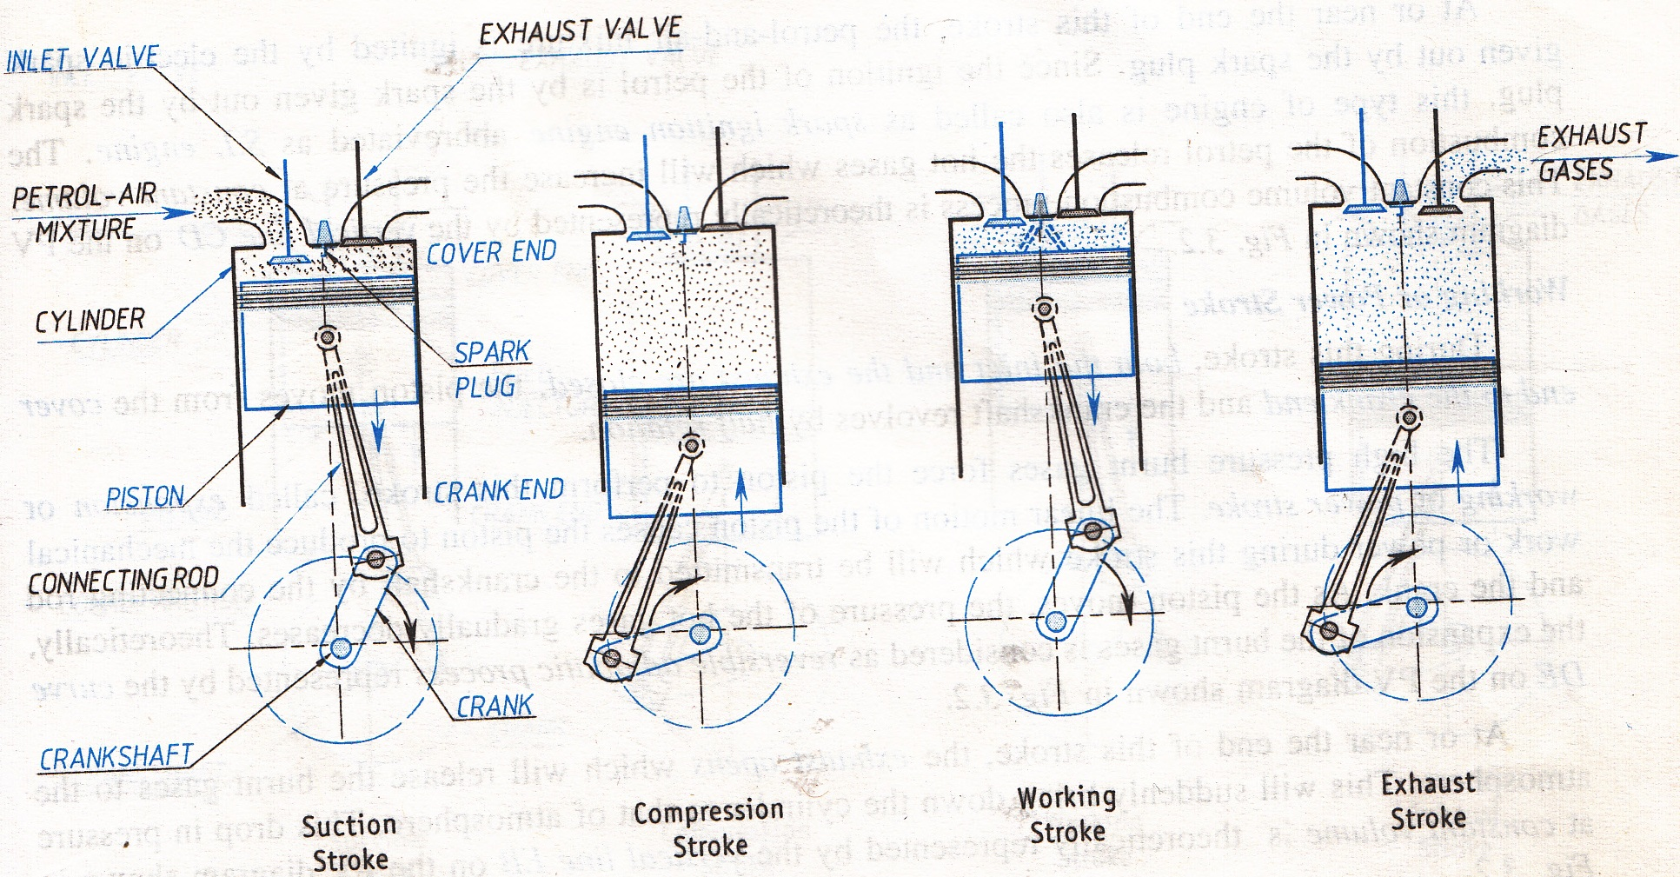
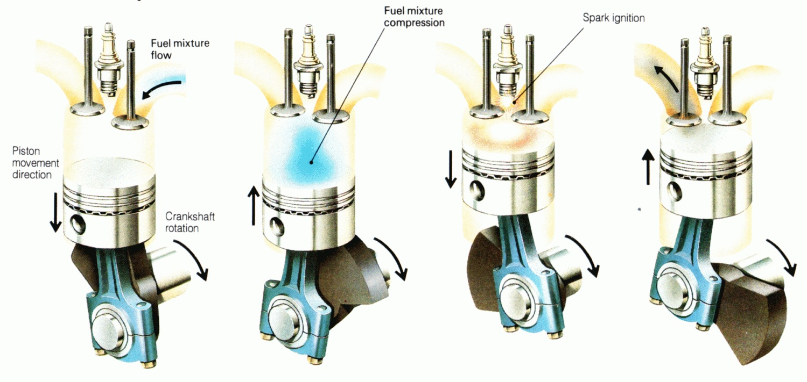

Slide 37
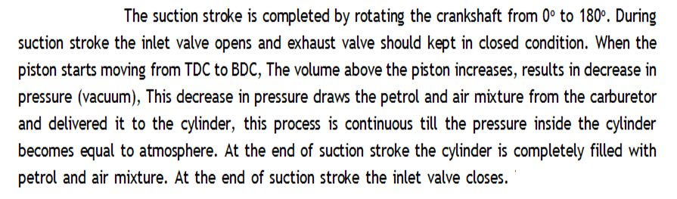
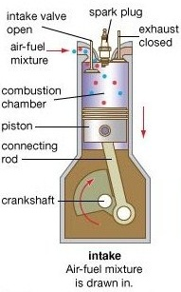
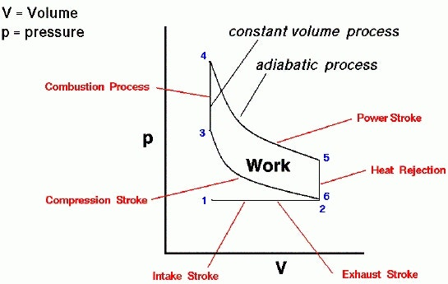
Suction Stroke

Slide 38
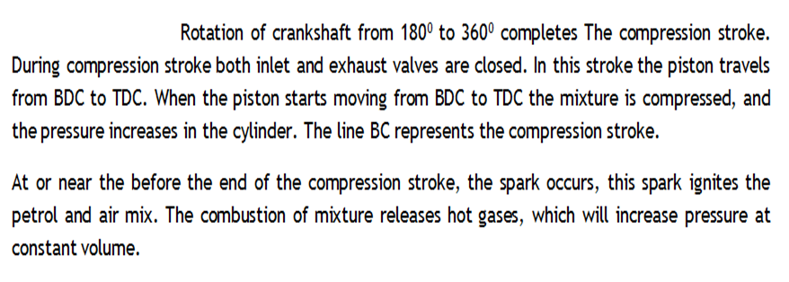
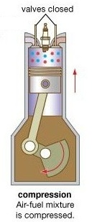
2. Compression Stroke

Slide 39
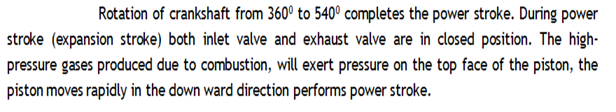
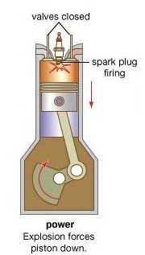
3. Expansion/working/power Stroke

Slide 40
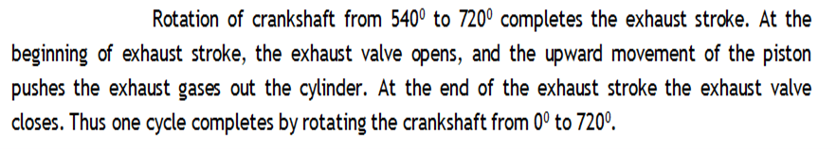
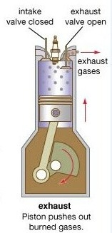
4. Exhaust Stroke

Slide 41
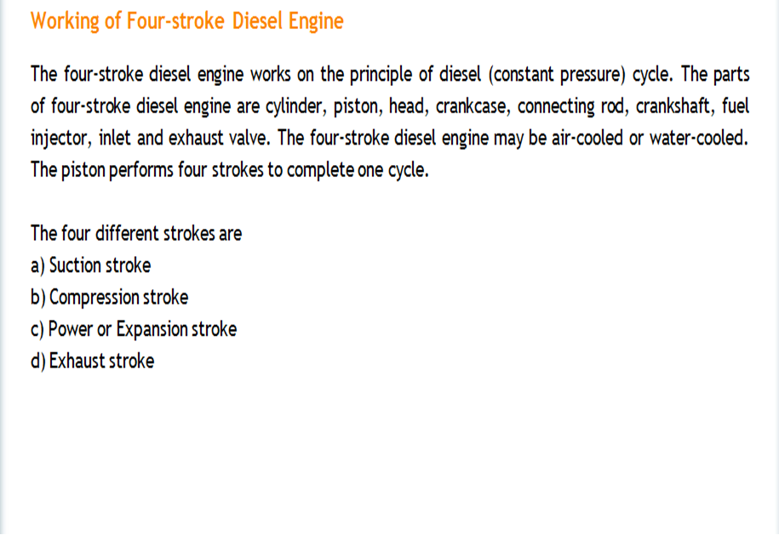
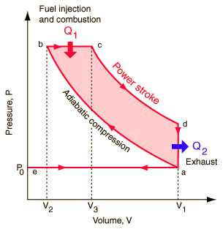
4 Stroke Diesel Engine

Slide 42
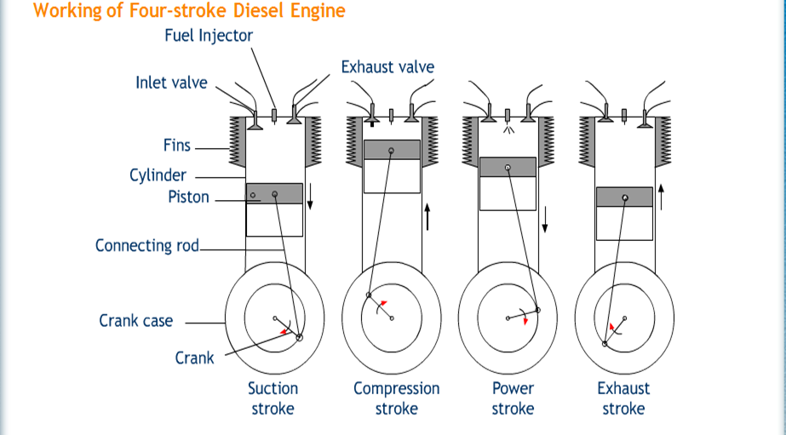


Slide 43


1. Suction Stroke

Slide 44



2. Compression stroke

Slide 45


3. Power/Expansion/working Stroke

Slide 46


4. Exhaust Stroke

Slide 47

2 Stroke Petrol Engine

Slide 48

Working of 2 Stroke Petrol Engine

Slide 49


Slide 50

2 Stroke Diesel Engine
The working of 2 strokes CI engine is very similar to 2 stroke SI engine. The main difference is that in CI engine supercharger air is used through the inlet port and in place of exhaust ports exhaust valves are used.
Pressurized air is inducted through the inlet port which expel the combustion gases through exhaust valve during the expansion stroke.
Inlet port and exhaust valve are closed during the compression stroke, piston moves from BDC to TDC. At the end of compression fuel is injected inside the cylinder and ignites and piston is forced to move from TDC to BDC. The same process is repeated again and again.

Slide 51


Comparison of 4 Stroke CI and SI engine
(CI Engine)
(SI Engine)

Slide 52
Principle of Refrigeration
In refrigeration, the heat is to be removed continuously from a system at a lower temperature and transfer it to the surroundings at a higher temperature.
This operation according to the second law of thermodynamics can only be performed by the aid of the external work.
Therefore in a refrigerator, power is to be supplied to remove the heat continuously from the refrigerator cabinet to keep it cool at a temperature less than the atmosphere.

Slide 53

Parts of Refrigerator
Refrigerant
Ammonia
Freon
Methyl Chloride
Carbon dioxide

Slide 54
List of refrigerants
1. Ammonia (NH3) – in vapor absorption refrigerators
2. Carbon dioxide (CO2)—in marine refrigerators
3. Sulphur dioxide (SO2)—in house hold refrigerators
4. Methyl chloride (CH3Cl)—in small scale refrigeration and domestic refrigerators.
5. Freon-12- in domestic vapor compression refrigerators
6. Freon-22- in Air conditioners.

Slide 55
Sl No | Refrigerant | Melting Point (Degree C) | Boiling Point (Degree C) | Sublimation Condition (Degree C)
1 | Ammonia (NH3) | -77.73 | -33.34
2 | Carbon dioxide (CO2) | -56.6 |  | -78.5
3 | Sulphur dioxide (SO2) | -73 | -10
4 | Methyl chloride (CH3Cl) | -97.4 | -23.8
5 | Freon-12 | -157.7 | -29.8
6 | Freon-22 | -175.42 | -40.7

Slide 56
Coefficient of performance
The COP of refrigeration system is defined as the ratio of heat absorbed in a system to work supplied.
T₁
COP
Heat removed
=
Work supplied
R
W
Q
T₂
T₁ > T₂

Slide 57
Ton of refrigeration
A ton of refrigeration is defined as the quantity of heat absorbed in order to form one ton of ice in 24 hours when the initial temperature of the water is 0 ˚C
In SI system
1 Ton of refrigeration = 210 kJ/min or 3.5 KW or 3.5 kJ/sec
Ice making capacity
Ice making capacity is defined as the capacity of refrigerating system to remove heat from water to make ice. It is usually specifed in kg/hr.

Slide 58

Working of Vapour Compression Refrigeration

Slide 59

Working of Vapour absorption Refrigeration
Notes:
Chiller in office buildings
Ammonia is solubable in a liquid known as absorbant.
Water having the capacity to absorbe the amonium vapour

Slide 60
Sl. No. | Principle | Vapour Compression system | Vapour Absorption system
1 | Working method | Refrigerant vapour is compressed | Refrigerant vapour is absorbed and heated
2 | Type of energy supplied | Works solely on mechanical energy. | Works solely on heat energy.
3 | COP | COP is higher, | COP is lower
4 | Noise | Noise is more due to the presence of the compressor | Almost quiet in operation as there is no compressor
5 | Leakage of Refrigerant | Due to high pressure, the chances of leakage of the refrigerant is more and is a major problem | Almost there is no leakage of the refrigerant
6 | Maintenance | The maintenance is high because of the compressor | The maintenance is low
7 | Operating cost | Is high due to electrical energy | Cost is less because energy required is less
8 | Refrigerant | Freon – 12 | Ammonia
Difference between Vapour Compression and Vapour absorption system

Slide 61
Steam Turbines
Machine generates power by converting the kinetic energy stream of fluid into mechanical energy, in the form of rotation of shaft.
Based on the type of fluid used turbines are classified into 3 types
Steam turbine
Water turbine
Gas turbine

Slide 62
A steam turbine is a device that extracts thermal energy from pressurized steam and uses it to do mechanical work on a rotating output shaft.
Because the turbine generates rotary motion, it is particularly suited to be used to drive an electrical generator

Slide 63
Steam Turbine may also be define as, a device which converts heat energy of the steam to the mechanical energy, which finally converted into electrical energy.

Slide 64
WORK IN A TURBINE VISUALIZED
A flowing fluid can have 3 components of energy
Kinetic energy - Virtue of its velocity
Pressure Energy - Virtue of its pressure
Internal Energy - Virtue of its temperature

Slide 65
CLASSIFICATION OF STEAM TURBINE
Classification of steam turbines may be done as following:
According to action of steam
(a) Impulse turbine (Thrust, a Push)
(b) Reaction turbine
(c) Combination of both
ROTOR
ROTOR
NOZZLE
STEAM CHEST
STEAM CHEST
Impulse steam turbine
Reaction steam turbine

Slide 66


2. According to direction of flow:
Axial flow turbine - Steam flows in a direction parallel to the axis of the turbine
Radial flow turbine - Steam flows in a direction perpendicular to the axis of the turbine.
3. According to number of stages
Single stage turbine
Multi stage turbine

Slide 67

(4)According to steam pressure at inlet of Turbine:
Low pressure steam turbine, the turbine with pressure up to 2 kg/cm2.
Middle pressure steam turbine, the turbine with pressure up to 40 kg/cm2.
High pressure steam turbine, the turbine with pressure 40 – 170 kg/cm2.
Very high steam turbine, the turbine with pressure exceeds 170 kg/cm2.
Super critical pressure steam turbine, the turbine with presse exceeds 225 kg/cm2
.
(5)According Exit condition of Steam:
(a) Condensing Turbine
(b) Non-Condensing Turbine

Slide 68
Classification of steam turbines
Impulse turbine- only kinetic energy of fluid being used while flowing over the turbine
Reaction turbine- both kinetic and pressure energy of the fluid being used while flowing over the turbine

Slide 69


IMPULSE TURBINE (De Laval turbine)

Slide 70

Propelling force in the Steam Turbine
When steam flows over the curved vane, it experiences change in the momentum.
This change in the momentum is responsible for force on the curved vane

Slide 71



Slide 72

IMPULSE TURBINE PRINCIPLE
ROTOR
NOZZLE
STEAM CHEST

Slide 73
PRESSURE-VELOCITY DIAGRAM FOR A MOVING IMPULSE BLADE
DIRECTION OF SPIN
REPRESENTS MOVING
IMPULSE BLADES
PRESSURE
TURBINE
SHAFT
ENTRANCE
HIGH VELOCITY
STEAM INLET
EXIT
LOW VELOCITY
STEAM EXHAUST
VELOCITY

Slide 74


REACTION TURBINE- Parson’s turbine

Slide 75
PRESSURE-VELOCITY DIAGRAM FOR A MOVING REACTION BLADE
DIRECTION OF SPIN
REPRESENTS MOVING
REACTION BLADES
PRESSURE
TURBINE
SHAFT
ENTRANCE
HIGH PRESSURE
HIGH VELOCITY
STEAM INLET
EXIT
LOW PRESSURE
LOW VELOCITY
STEAM EXHAUST
VELOCITY

Slide 76


Slide 77


Slide 78
Difference Between Impulse Turbine and Reaction Turbine
Impulse turbine | Reaction turbine
Complete expansion of steam takes place in the nozzle. | Partial expansion of steam takes place in the fixed blades and further expansion takes place in the moving blades.
Blades are symmetrical in shape. | Blades are non symmetrical in shape i.e., aerofoil section.
The rotor runs at higher speeds. | The rotor runs at relatively low speed.
The impulse turbines are used for small power generation plant. | The reaction turbines are used in large power generation plant.
Less floor area is required.(small power plant). | More floor area is required. (Medium and large power plant).
The pressure of steam remains constant from inlet to the outlet of the blade. | The pressure of steam drops from inlet to the outlet of the blade.

